Slide 1
AWS VPC
Virtual private cloud

Slide 2
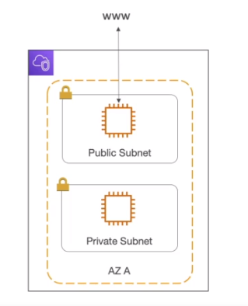
VPC & Subnet
VPC :Private network to deploy your resource(regional resource)
Subnets allows you to partition your network inside your VPC(AZ Resource)
A public subnet is a subnet that accessible from the internet
A private subnet that cannot accessible from the internet
To define access to the internet and between subnet, we use Route Tables.

Slide 3
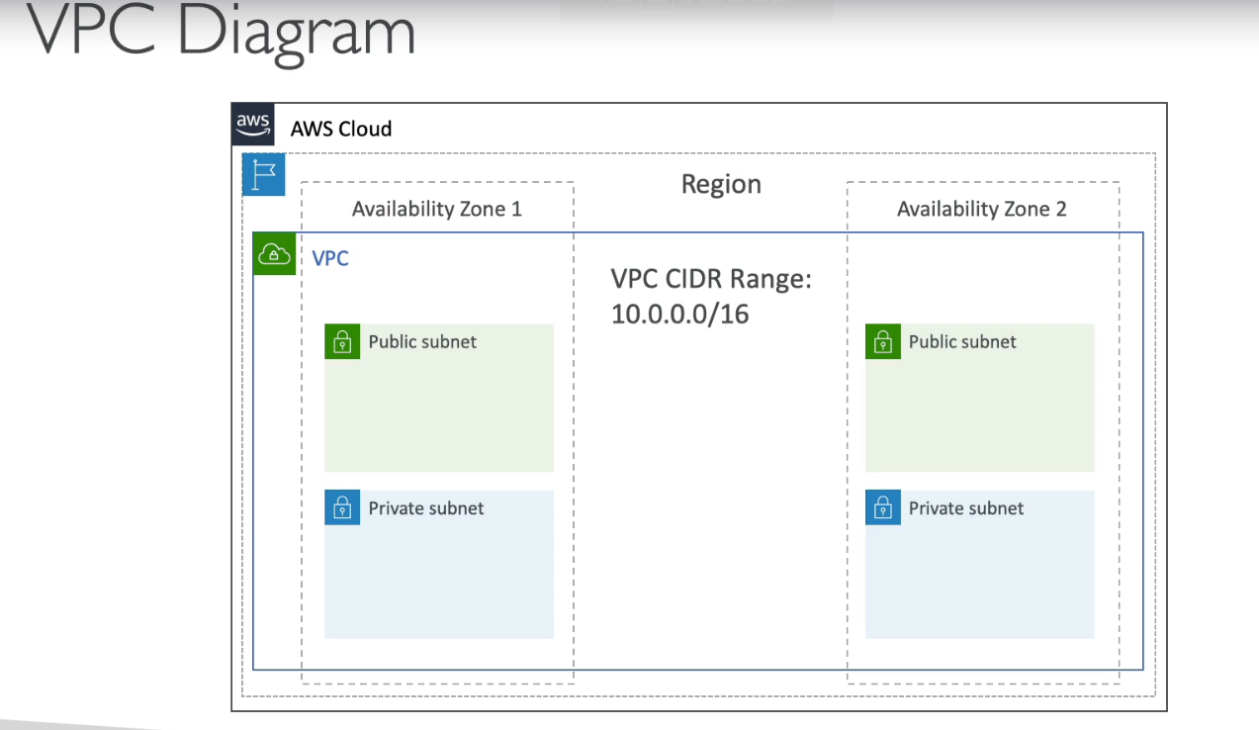

Slide 4
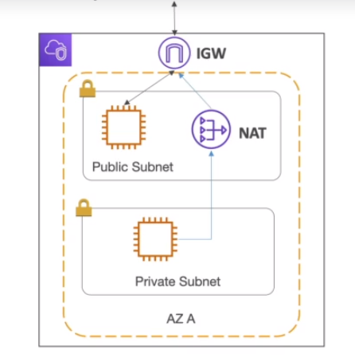
INTERNET GATEWAY AND NAT GATEWAYS
Internet gateway helps vpc instances connect with the internet
Public subnet have route to the internet gateway.
NAT gateway(AWS managed)&NAT instances(self managed)
allow your instances in your private subnets to access
the internet while remaining private

Slide 5
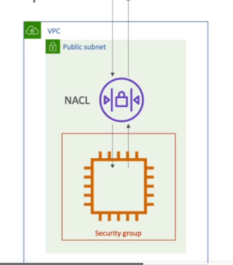
NETWORK ACL AND SECURITY GROUPS
NACL(network ACL):
A firewall that controls the traffic from/to subnet.
Can have allow/deny rules
Are attached at the subnet level
Rules only include ip address
Security groups:
A firewall that controls the traffic from/to ENI/EC2 instance
Can have allow rules
Rules includes ip address and other security groups.

Slide 6
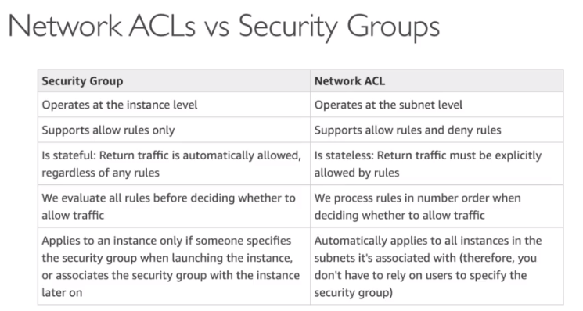

Slide 7
VPC Flow log
Capturing information about ip going into interfaces:
vpc flow log
Subnet flow log
Elastic network interface flow log
Help in monitoring and trouble shoot connectivity issues.
subnet to internet
Subnet to subnet
Internet to subnet
Captures network information from AWS managed interfaces too: ELB, Elastic catches, RDS, ect.,
VPC flow log data can go to S3/ cloud watch log

Slide 8
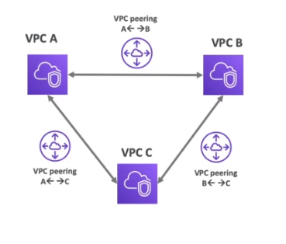
VPC Peering
Connect two VPC,Privately using AWS’ Network
Make them behave as if they were in same network
Must not overlapping CIDR(ip address range)
VPC Peering is not transitive

Slide 9
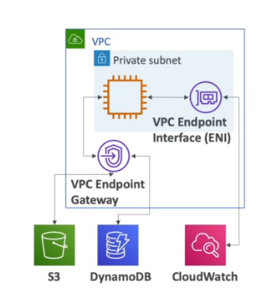
END POINTS
End points are allowed to connect AWS Services using private network instead of public internet network.
This gives enhance security and low latency to access AWS services
VPC Endpoint gateways:S3/DynamoDB.
VPC interface :rest
Only used within VPC

Slide 10
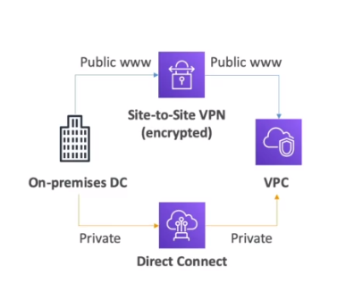

VPN (Site -to-Site VPN & Direct Connect)
Site-to-Site VPN
Connect an on premise to AWS
The connection is automatically encrypted
Goes over the public internet
Direct Connect:
Establish physical connection
an on premise to AWS
The connection is secure, private and fast.
Goes over the private network
Takes least month to establish

